Slide 1
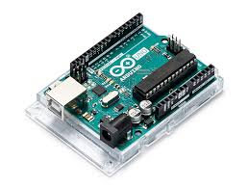

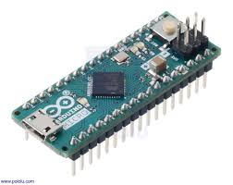
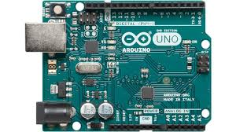

CS341 Lab Introduction
Spring 2021

Slide 2
Contact info
emma.kelminson001@umb.edu
Office hours are available by request, just email me
All class material, lab report submissions, and grades will be viewable on or done through LINUX server. Detailed guide posted on Piazza.
Zoom links and class updates are/will be posted to piazza
Feel free to email me with any concerns

Slide 3
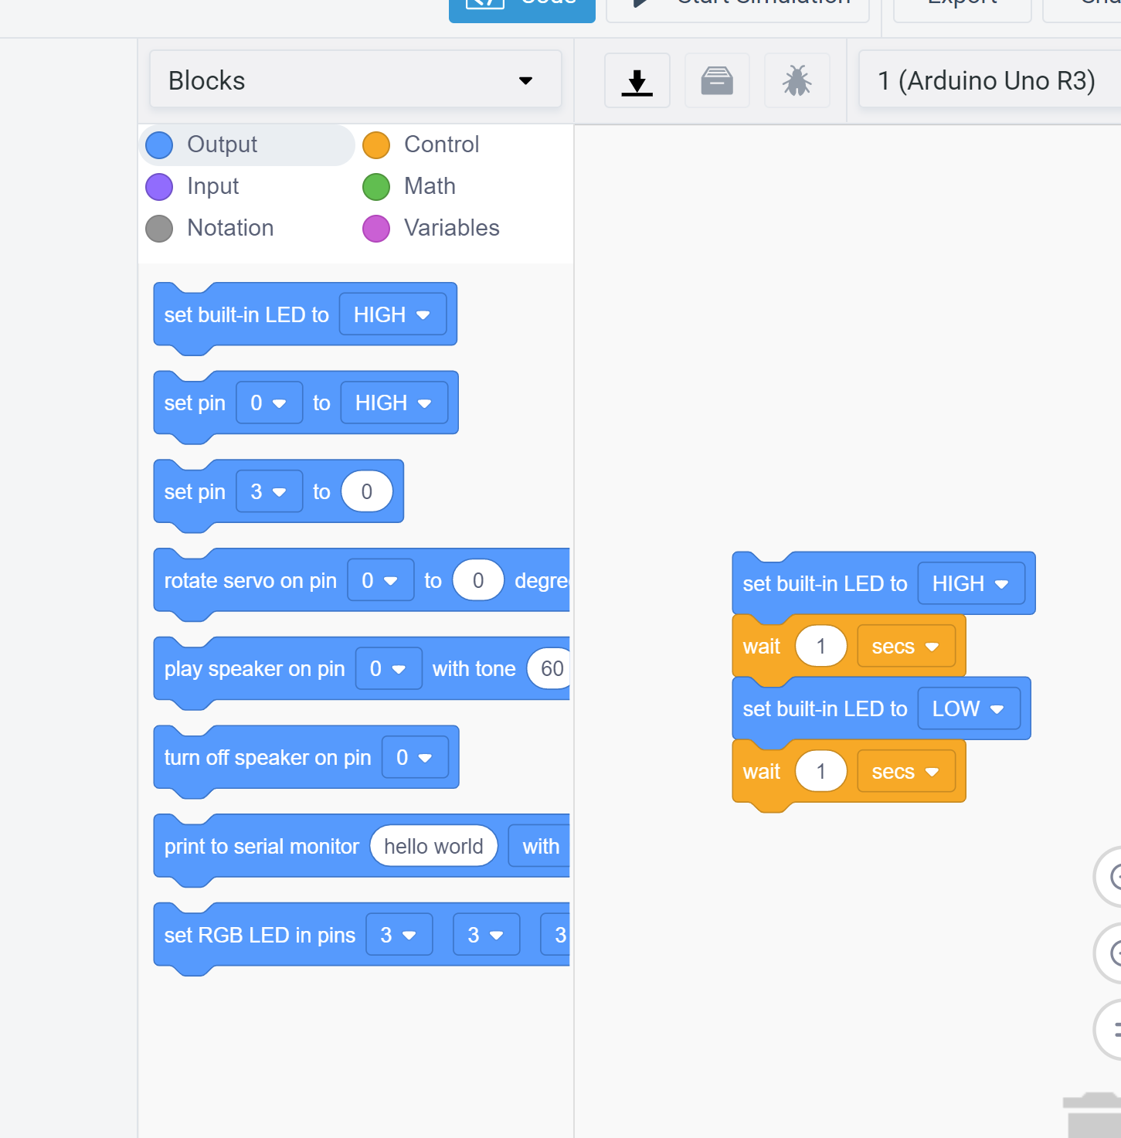
Policies
Work in groups of 2 or individually
Post lab questions on Piazza with lab tag (privately if you need to share code)
Each lab is due by the start of class, usually a week
Submit labs in proper form detailed on guide
Makeup labs are allowed for a max of 7/10 points. All labs due by 5/14 at midnight
No block code on tinkercad

Slide 4
Linux server setup for labs after lab 3
CS341
labs
lab_1
lab_2
lab_3
grades.txt
lab_report1.pdf
lab_report2.pdf
lab_report3.pdf
-All material originally posted to /courses/cs341/s21/cheungr/labs

Slide 5
Weekly Meetings
Starter code, presentation, and lab instructions (also posted on class website) will be posted on the linux server each week by tuesday
Lab introduction
Working lab demonstration
Q&A
Breakout rooms for real-time labs
Use the “help” button (under more) to get my attention
You are welcome to leave early or try while I’m here to answer questions

Slide 6
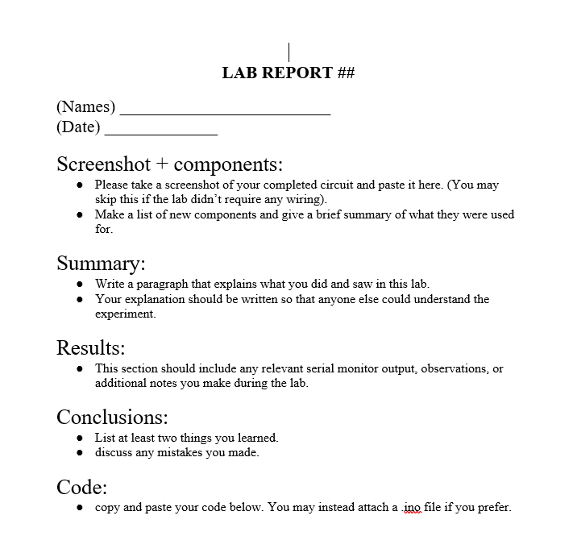
Lab report template
Labs can be written and submitted as a team
Submit through Linux server. Guide posted on Piazza that details where to leave them and how if shakey on the process
There will be 10 labs
labs make up 20% of your final grade
If you can’t get your code working in time, please document what you tried and submit the lab anyway
Item | Points worth
Code correctness | 3
Submission form correct | 3
Report contains accurate information | 2
Some effort put into report | 2

Slide 7
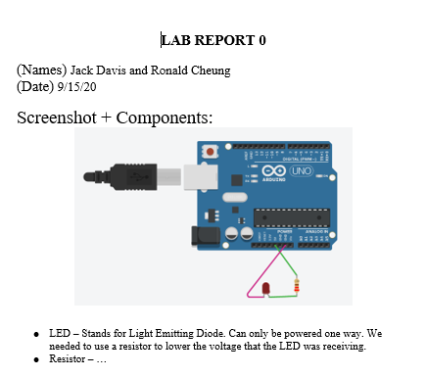
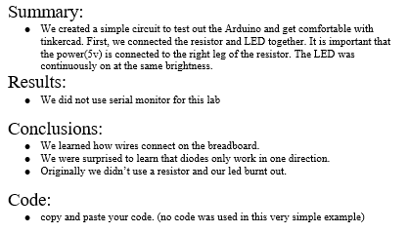
Sample Lab Report
Emma Kelminson

Slide 8
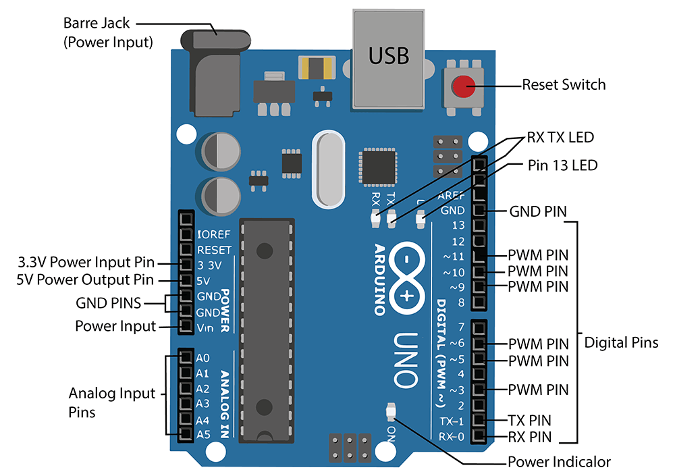
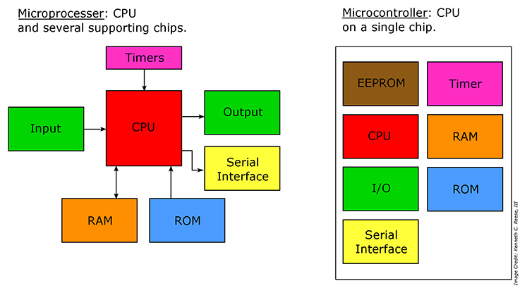
Arduino
Arduino is an open source software platform used for coding Arduino boards
Hardware(the boards):
Components powered by power supply and controlled by microcontroller
Microcontroller vs Microprocessor
Read input turn into output
Connect to various I/O device
-For more detailed explanation of parts: https://www.hackerearth.com/blog/developers/a-tour-of-the-arduino-uno-board/

Slide 9
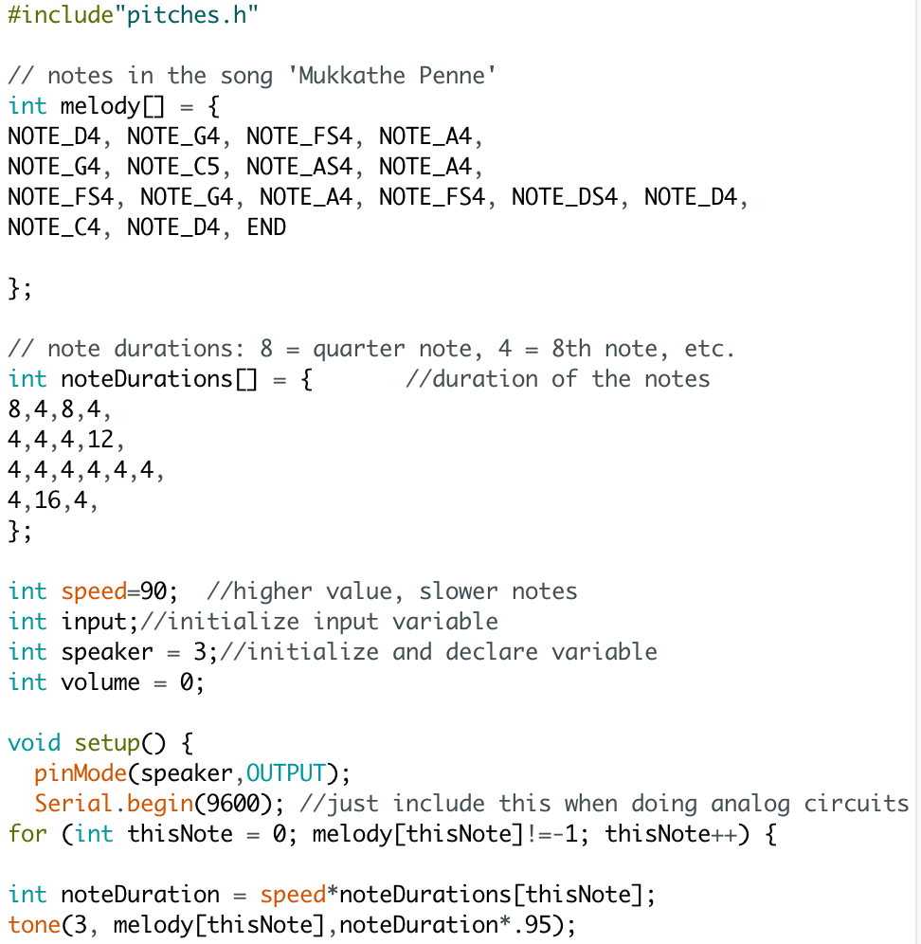
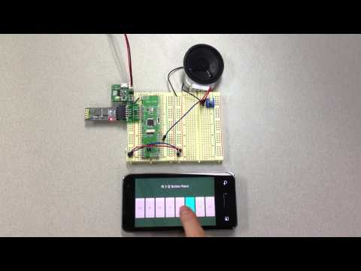
Arduino part II: The Software-ing
Loaded to the arduino through USB
Programmed in the Arduino Software, a specialized IDE.
Coded in a C/C++ like language called the Arduino Language.
https://www.arduino.cc/reference/en/
Software + Hardware used to make all sorts of projects

Slide 10
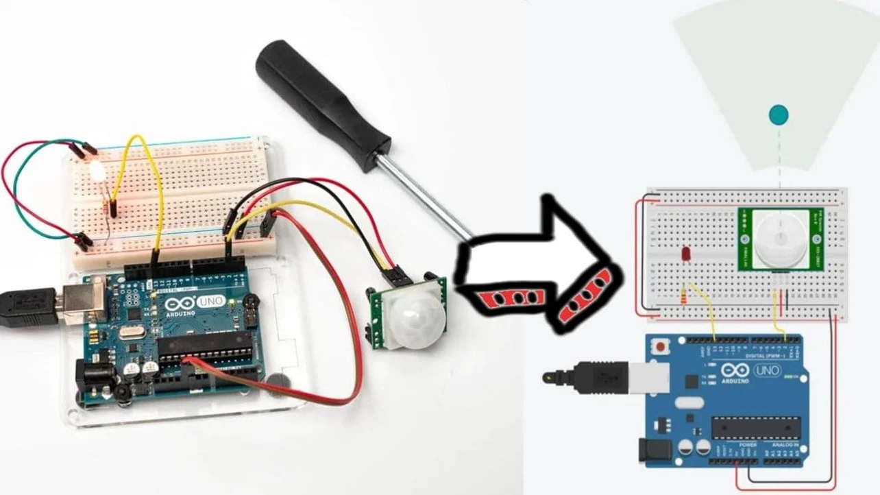
Luckily we have tinkercad:
-https://www.tinkercad.com/things/22o4bcydRyR-copy-of-super-mario-theme/editel?tenant=circuits

Slide 11
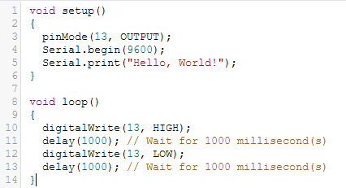
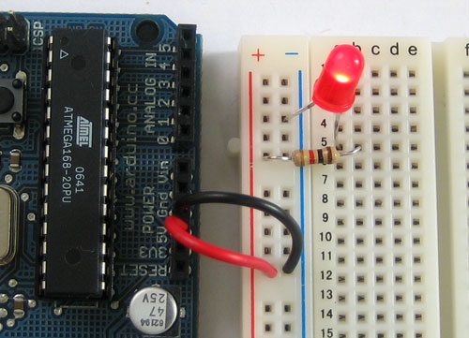
Today’s lab
setup() and loop() must be present for code to compile
Serial.begin(9600) initializes the Serial monitor (a text window that we can print to)
delay(int x) waits x milliseconds (needed often to actually observe output)
To use a pin:
First initialize it as either INPUT or OUTPUT using pinMode()
digitalWrite(int pinNumber, HIGH or LOW)
More options will come in future labs

Slide 12
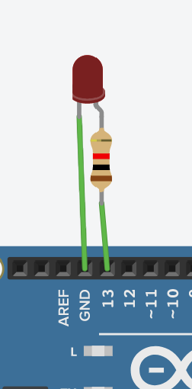
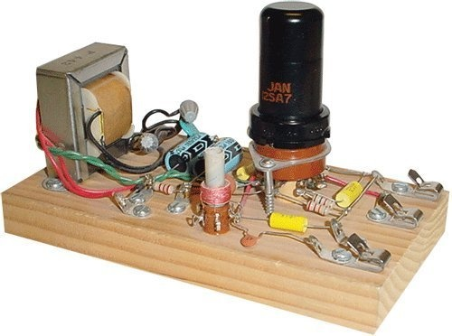
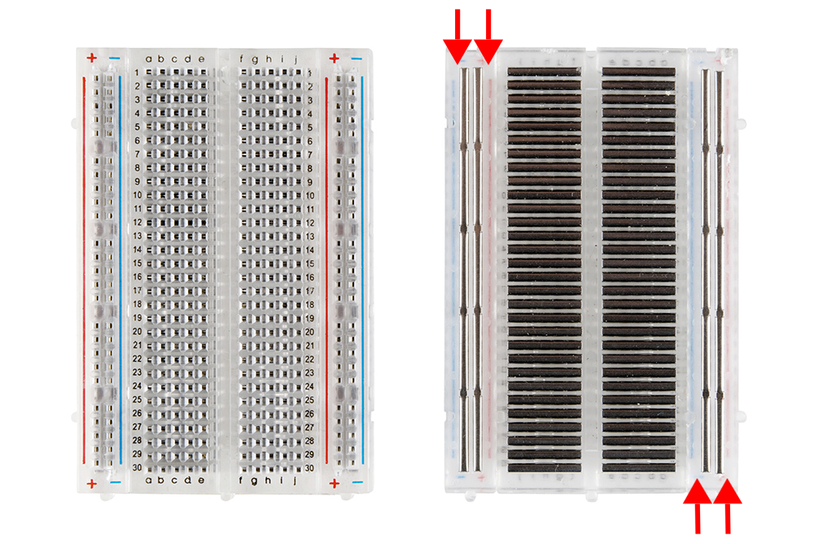
The Components of Today: Breadboard
Not strictly needed because we can easily wire components together through tinkercad (imagine soldering a wire to a tiny lil LED sprongs)
IRL much easier to plug wires and components into breadboard
Underneath the lil pinholes are pieces of metal that either connect 5 pins or 25 pins.

Slide 13
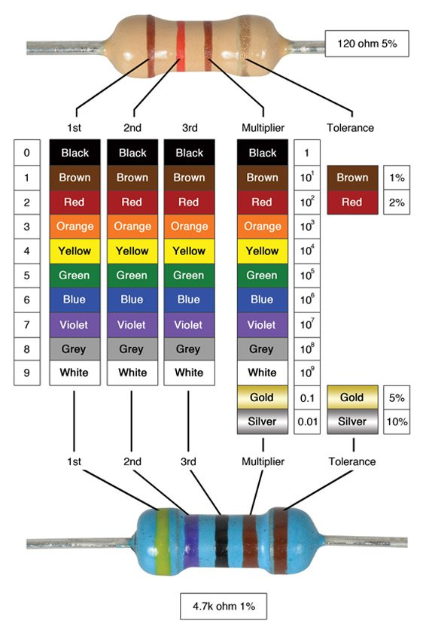
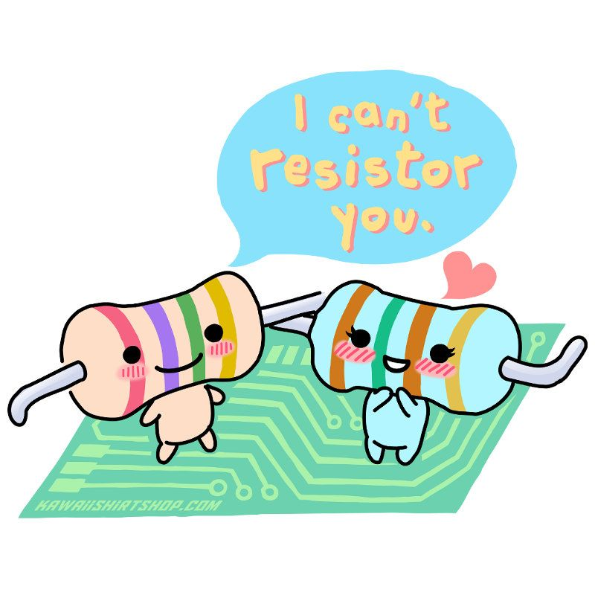
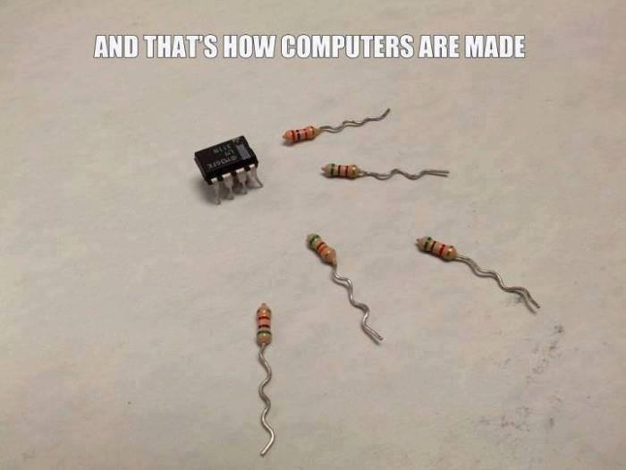
The Components of Today: Resistor
-https://www.tinkercad.com/things/22o4bcydRyR-copy-of-super-mario-theme/editel?tenant=circuits
Needed to control the amount of electricity flowing
Measured in Ohms(Ω)

Slide 14
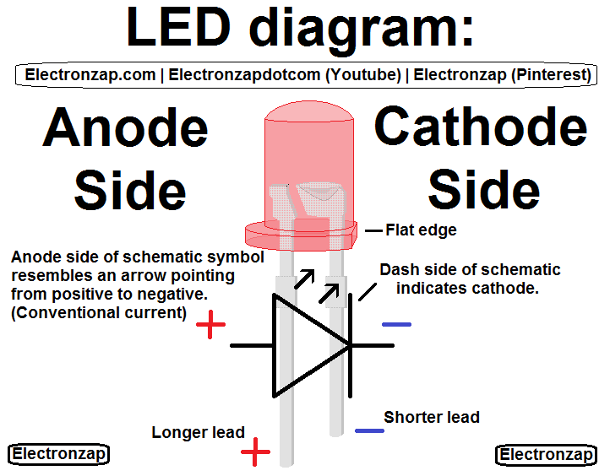
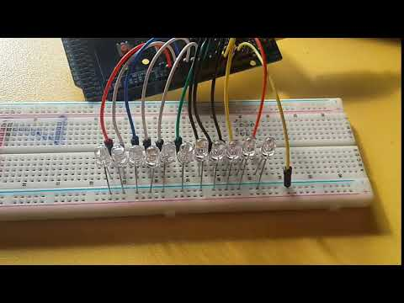
The Components of Today: LED
Power must flow anode (longer lead, round) to cathode or positive to negative ((circuit inside only setup for one direction.
Keep this in mind for today’s lab. Which pin are we outputting power to? Connect the anode side accordingly
A change in the amount of electricity flowing causes a change in brightness

